Slide 1




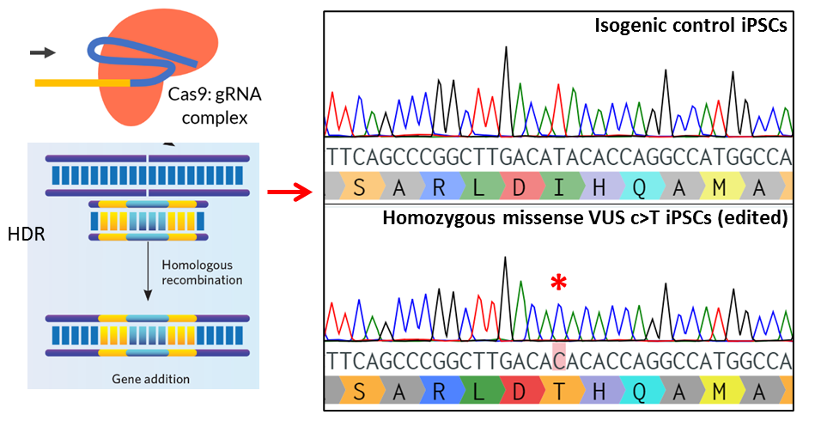
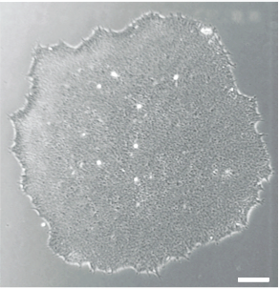
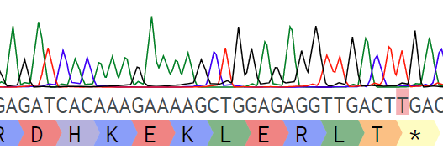




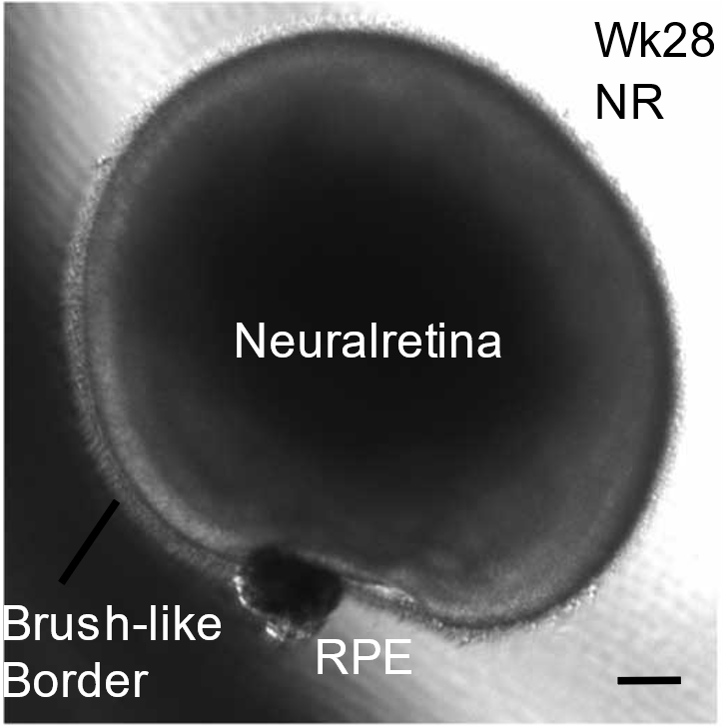


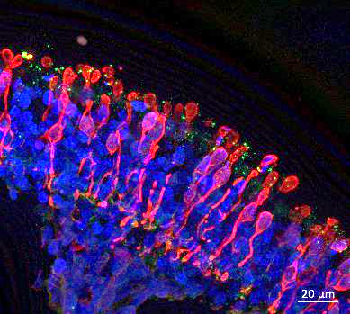

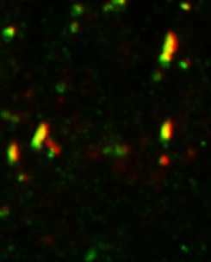
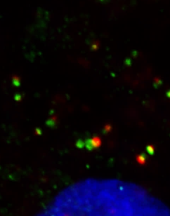
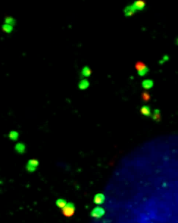
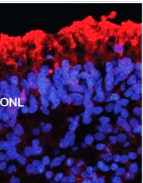
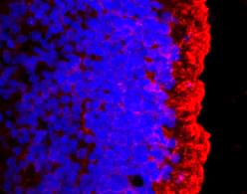
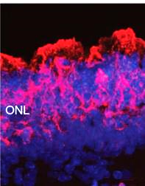
Precision medicine for the retinal dystrophies: modelling using human stem cell retinal organoids
To Ha Loi¹, Anson Cheng¹, Milan Fernando², Benjamin M Nash^{1,3,4}, Anai Gonzalez Cordero², Robyn V Jamieson^{1,3,4}
1. Eye Genetics Research Unit, Children’s Medical Research Institute, Sydney Children’s Hospitals Network-Westmead, Save Sight Institute, University of Sydney, New South Wales, Australia
2. Stem Cell Medicine Group, Children’s Medical Research Institute, University of Sydney, New South Wales, Australia
3. Sydney Genome Diagnostics, Western Sydney Genetics Program, The Children’s Hospital at Westmead, Sydney, New South Wales, Australia
4. Specialty of Genomic Medicine, Faculty of Medicine and Health, University of Sydney, New South Wales, Australia
ccc
Introduction
ccc
Genetic retinal dystrophies
Results
Genetic retinal dystrophies lead to the progressive degeneration of photoreceptors resulting in vision loss.
Located in the retina, the photoreceptors are a specialised sensory cilium
that respond to light.
Majority of disease genes encode ciliary proteins.
Our genomic studies identify the disease-causing variants in 50-60% of cases, however for 10-15% cases there may be one or more variants of uncertain significance (VUS) hindering full genetic diagnosis.
CRISPR/Cas9 genome editing of control human iPSCs
A. CRISPR/Cas9 mediated knock in of MS VUS in normal iPSCs, correct editing (homozygous) verified by Sanger sequencing. B. Genotyping of iPSCs created from a RPGRIP1-LCA patient verifying presence of a homozygous stop mutation in RPGRIP1. C. Western blot analysis conforming loss of RPGRIP1 protein expression in RPGRIP1 patient ROs.
A.
Disease genes in retinal dystrophies
Nash et al, Translational Pediatrics, 2015.
B.
Patient iPSCs
C.
In this project, we are developing an approach for analysis of VUS in the ciliary disease genes, with applicability for other retinal diseases genes. We are also using this model to test novel genetic therapies.
Clinical case: Patient with the retinal dystrophy Leber Congenital Amaurosis (LCA) and a novel heterozygous missense VUS in RPGRIP1 with conflicting in-silico reports of deleterious effects.
Ctrl
Patient RPGIP1-LCA
MS-VUS
RPGRIP1
β-actin
Human iPSC differentiation into retinal organoids
A.
B.
C.
CRX Recoverin
Cone arrestin RPGRIP1 Dapi
RPGRIP1
A. Excised neural retinal organoid grown in suspension for 28 weeks. B–C. IHC analysis of wk 24 control organoids. Photoreceptors develop on the outer aspect of organoids, expressing early neural retinal markers CRX and recoverin and inner segment marker cone arrestin. Ciliary protein expression of RPGRIP1. ONL: outer nuclear layer. D. IHC analysis of wk 30 control and RPGRIP1 mutant organoids showing abnormal CEP290 and RPGR costaining, and E. mislocalised rhodopsin rod photoreceptors.
RPGR-interacting protein 1, a ciliopathy gene causing cone-rod dystrophy, recessive LCA and retinitis pigmentosa.
Found in the ciliary transition zone (TZ) of photoreceptors where it anchors RPGR and controls microtubule organisation.
Trafficks key proteins between the inner and outer segments of photoreceptors for development and maintenance.
Exclusively expressed in photoreceptors, including in retinal organoids.
ONL
ONL
RPGRIP1
10µm
Control wk 24
200µm
Control, wk24
D.
Missense VOUS
RPGRIP1-LCA
Isogenic control
ONL
ONL
20µm
20µm
Schematic of the photoreceptor showing the outer segment, a specialised sensory cilium. Example ciliary protein localisations shown.
CEP290 RPGR
CEP290 RPGR
ONL
CEP290 RPGR
ONL
ONL
AIMS
E.
To genome edit normal human induced pluripotent stem cells (iPSCs), to introduce the RPGRIP1 novel missense VUS, differentiated to retinal cells to evaluate photoreceptor ciliary function and as a platform to test gene-based therapies.
Isogenic control
Missense VOUS
RPGRIP1-LCA
ccc
ONL
Methods
CRISPR/Cas9 homology directed repair (HDR): Selected sgRNA cloned into spCas9 plasmid (62988) plus single-stranded oligonucleotide (150nt donor carrying the mutations) were delivered into normal human iPSCs (HipSci.org) by nucleofection. Following 24h transient puromycin selection, surviving iPSC clones were screened by PCR amplification and Sanger DNA sequencing to verify correct editing.
For comparison to our novel variant analysis and for disease modelling, we have also created iPSCs from a patient with a known pathogenic variant in RPGRIP1. Derivation of iPSCs from patient PBMCs was done by episomal reprogramming with the Yamanaka factors.
iPSC differentiation into retinal organoids: hiPSC variant lines and isogenic controls were maintained in mTESR1™ medium and differentiated into retinal organoids using established methods. Within 5 weeks, retinal vesicles formed and were dissected and further differentiated into organoids.
Immunohistochemistry: Retinal organoids were fixed in 4%PFA, cryoprotected in 20% sucrose and embedded in 100% OCT for cryosectioning and immunofluorescence staining.
Rhodopsin Dapi
Rhodopsin Dapi
Rhodopsin Dapi
Summary
Genome editing was used to generate isogenic iPSC lines differentiated into retinal cells for disease modelling of a novel missense variant of a ciliopathy gene, RPGRIP1.
A patient derived iPSC line harbouring a homozygous stop variant in RPGRIP1 was also created for phenotypic comparison.
Biomarkers for retinal organoid characterisation for RPGRIP1 and other ciliopathy related disease are in progress and replacement therapy constructs are in design.
This approach will be used to examine other VOUS and as a platform to test AAV mediated gene replacement and other genetic therapy strategies.
Acknowledgements
Funding: NHMRC grant 1099165, Ophthalmic Research Institute of Australia (ORIA) and Cure Blindness Australia. We wish to acknowledge members of the Vector and Genome Engineering Facility at CMRI for assistance in this project.

